Slide 1

Introduction to Biostatistics & R
SUIP Biostatistics Workshop
Thursday, June 8, 2023
Session 3

Slide 2
Warm-Up Exercise
Today we’re interested in patients with hypercholesterolemia (high cholesterol)
Using the mydata dataset, create a dataframe of these patients
Provide some descriptive statistics of this cohort with respect to age
Minimum, maximum, average, standard deviation, variance
Which single function gives most of these as output?
Create a histogram depicting the age of this cohort
How many males and females are in this cohort?

Slide 3
Outline for Today’s Workshop
Finish descriptive statistics:
Calculation correlations
Important practical matters in R
Installing and loading packages
Introduce plots
Plots using “base” R
Plots using a different package: ggplot2
Briefly introduce tools for statistical inference in R

Slide 4
Correlating two variables

Slide 5
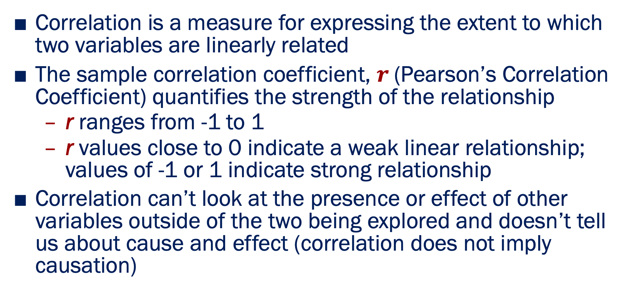
Correlations
Correlation is a measure for expressing the extent to which two variables are linearly related
The sample correlation coefficient, $r$(Pearson’s Correlation Coefficient) quantifies the strength of the relationship
r ranges from -1 to 1
r values close to 0 indicate a weak linear relationship; values of -1 or 1 indicate strong relationship
Correlation can’t look at the presence or effect of other variables outside of the two being explored and doesn’t tell us about cause and effect (correlation does not imply causation)

Slide 6
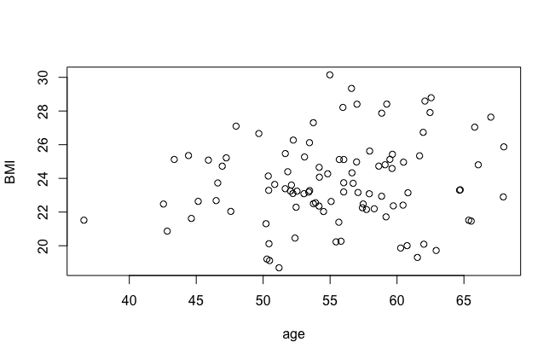
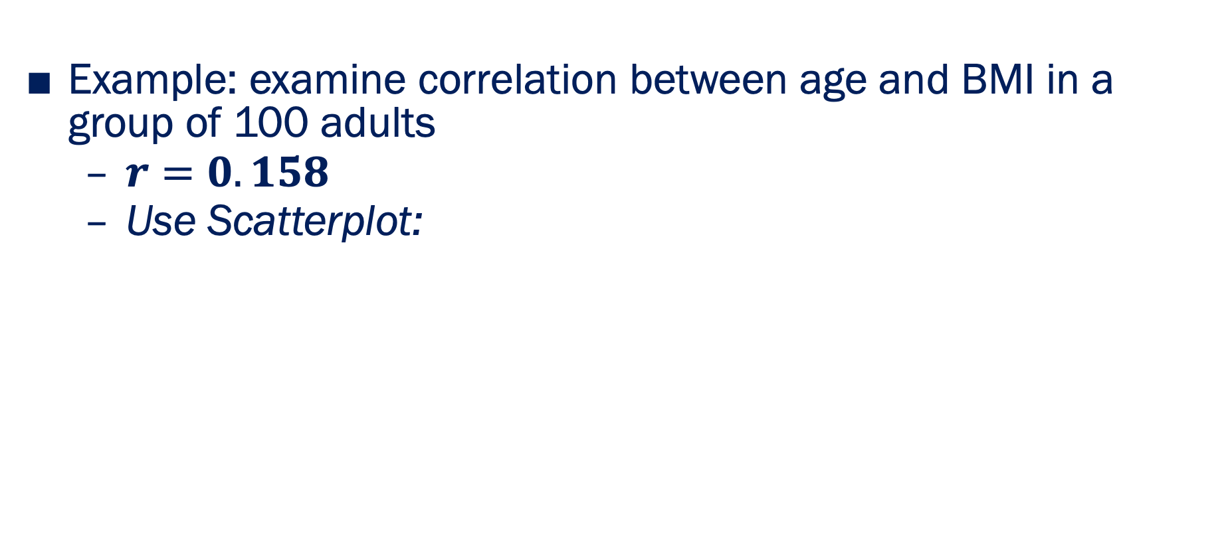
Correlations
Example: examine correlation between age and BMI in a group of 100 adults
$r=0.158$
Use Scatterplot:

Slide 7
Correlations in R
> cor(data$Age, data$BMI)
[1] 0.01151343

Slide 8
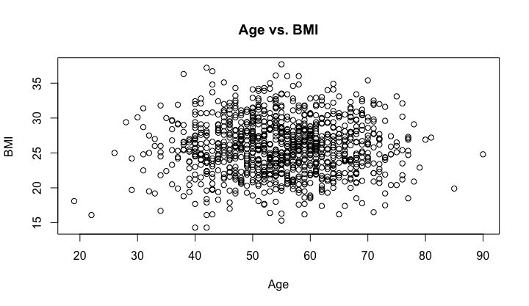
Using scatterplots to understand the relationship between two variables in R
> plot(data$Age, data$BMI, xlab = "Age", ylab = "BMI", main = "Age vs. BMI")
There does not appear to be any obvious linear relationship here!

Slide 9
Try it yourself:
Exercise 2.1.6: Correlations
Calculate the correlation between the BMI and Systolic Blood Pressure of each subject using cor()
Use plot() to plot BMI vs. Systolic Blood Pressure to further assess for a linear relationship between these variables.

Slide 10

Concluding summary statistics:
Suppose we have a vector of data, e.g.
$$x=(68, 65, 64, …,70, 58)$$
Statistic | Function in R
Sum | sum(x)
Mean | mean(x)
Median | median(x)
Largest Value | max(x)
Smallest Value | min(x)
Standard Deviation | sd(x)
Variance | var(x)
Number of elements | length(x)
Correlation between x and y | cor(x,y)

Slide 11
Important Practical Matters in R:
Installing and loading packages

Slide 12
Packages
•
What is a package?
•
•
•
•
A collection of R functions and data sets that someone has contributed to the R “ecosystem”
Packages extend the functionality of R: most of the value to R comes from the 5000+ packages out there
If you can’t find a function in “base” R, it might be available in a package
People often write their own packages for easy access to functions, new statistical methods, etc.

Slide 13
Installing packages
Example: ggplot2
An excellent R package for even better data visualization
# Install package
install.packages("ggplot2")
# Then, subsequently load that package
library(ggplot2)

Slide 14
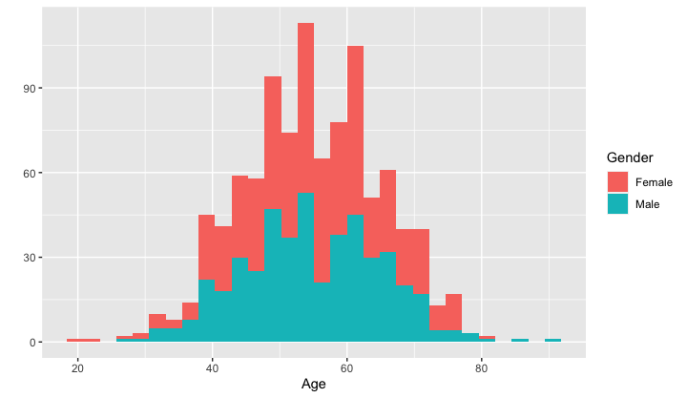
Example of what ggplot2 can do
Make an even fancier histogram!

Slide 15
Example of what ggplot2 can do
We will be exploring ggplot2 today, so more on this later!
Make an even fancier histogram!

Slide 16
Try it yourself:
Exercise 3.1.1: Installing Packages
Install ggplot2 using install.packages()
Load ggplot2 using library()

Slide 17
Plots in R

Slide 18
Plots in “base” R
Base R offers graphics for producing many simple plots, for example:
scatter plots - plot()
histograms - hist()
bar plots - barplot()
pie charts - pie()
box plots - boxplot()

Slide 19
Plots in “base” R
Base R offers graphics for producing many simple plots, for example:
scatter plots - plot()
histograms - hist()
bar plots - barplot()
pie charts - pie()
box plots - boxplot()
We covered some of these last week and will talk about more advanced plots this week!

Slide 20
ggplot2 package in R (1)
Graphing package inspired by the Grammar of Graphics work of Leland Wilkinson.
A tool that enables to concisely describe the components of a graphic.
Why ggplot2?
Flexible
Customizable
Pretty !
Well documented

Slide 21
ggplot2 package in R (2)
In ggplot2, we can make:
Scatter plots
Histograms
Box plots
Dot plots
Bar plots
Volcano plots

Slide 22
Getting started with ggplot2
Load package:
library(ggplot2)
All ggplots start with a base layer created with the ggplot() function:
ggplot(data=dataframe, mapping=aes(x=Age, y=BMI))
The base layer is setting the grounds but NOT plotting anything.

Slide 23
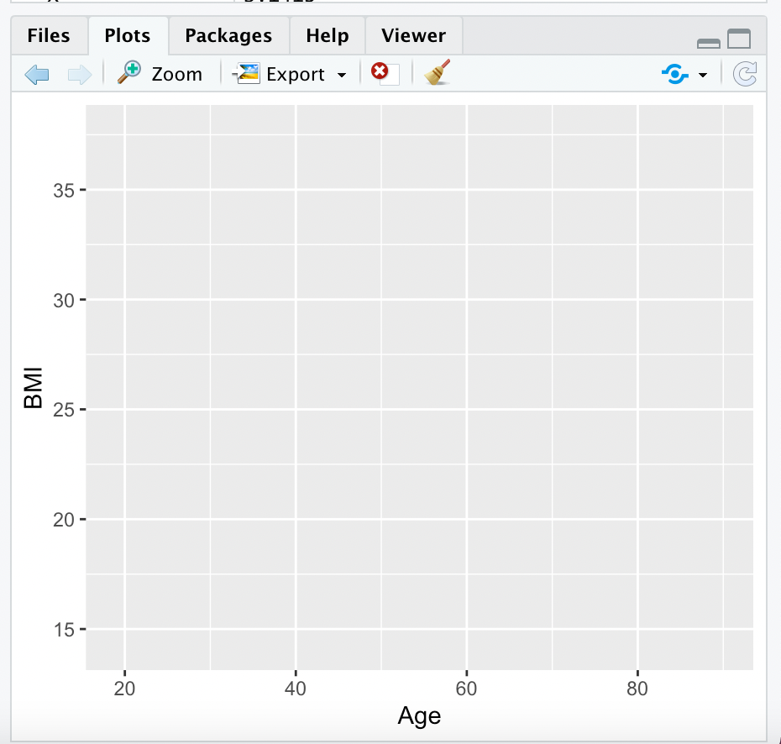
Getting started with ggplot2
Load package:
library(ggplot2)
All ggplots start with a base layer created with the ggplot() function:
ggplot(data=dataframe, mapping=aes(x=Age, y=BMI))
The base layer is setting the grounds but NOT plotting anything.

Slide 24
Getting started with ggplot2
Load package:
library(ggplot2)
All ggplots start with a base layer created with the ggplot() function:
ggplot(data=mydata, mapping=aes(x=Age, y=BMI))
The base layer is setting the grounds but NOT plotting anything.
You then add a layer (with the + sign) that describes what kind of plot you want:
geom_point()
geom_bar()
geom_histogram()
geom_boxplot()
…
And then you will add one layer at a time to add more features to your plot!

Slide 25
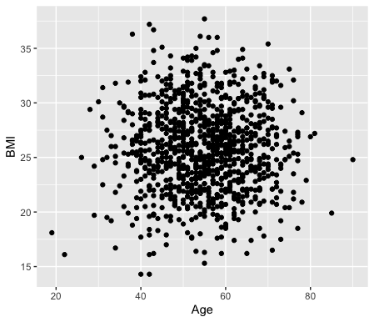
Scatterplot with ggplot2
Example of a scatter plot: add the geom_point() layer ggplot(data=mydata, mapping=aes(x=Age, y=BMI)) +
geom_point()

Slide 26
Scatterplot with ggplot2 -- more layers
Add layers to that object to customize the plot:
ggtitle to add a title
geom_vline to add a vertical line
ggplot(data=mydata, mapping=aes(x=Age, y=BMI)) +
geom_point() +
ggtitle(label="my first ggplot") +
geom_vline(xintercept=54.897)

Slide 27
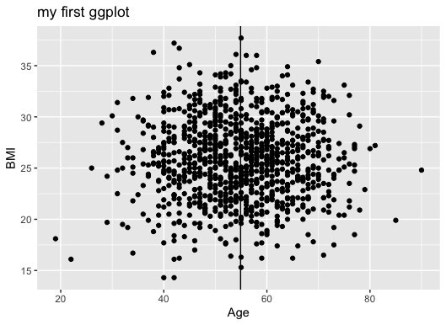
Scatterplot with ggplot2 -- more layers
Add layers to that object to customize the plot:
ggtitle to add a title
geom_vline to add a vertical line
ggplot(data=mydata, mapping=aes(x=Age, y=BMI)) +
geom_point() +
ggtitle(label="my first ggplot") +
geom_vline(xintercept=54.897)

Slide 28
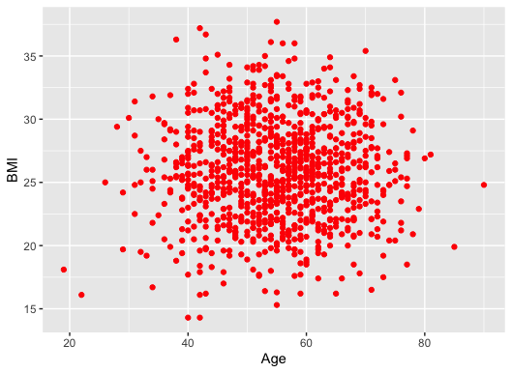
Scatterplot with ggplot2 -- more layers
Color all points in red (not depending on the data):
ggplot(data=mydata, mapping=aes(x=Age, y=BMI)) +
geom_point(color="red")

Slide 29
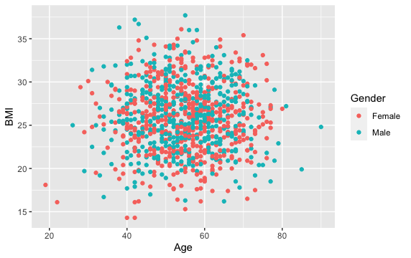
Scatterplot with ggplot2 -- more layers
Color the points according to a categorical variable in the data frame (such as Gender)
ggplot(data=mydata, mapping=aes(x=Age, y=BMI, color=Gender)) +
geom_point()

Slide 30
Try it yourself:
Exercise 3.1.2: Scatterplots
First, try using ggplot2 without adding any layers to see what happens. Run the command: ggplot(data=mydata, mapping=aes(x=Age, y=BMI))
Add a layer to create a simple scatter plot representing “Age” on the x-axis and “BMI” on the y-axis.
Color the points of the scatter plot according to each person’s gender
Use ggtitle to add a title to your plot
Use geom_vline to add a vertical line for the mean Age in the dataset (can calculate this using mean(mydata$Age), as we learned last week)
Practice saving your ggplot to your local files using “Export”

Slide 31
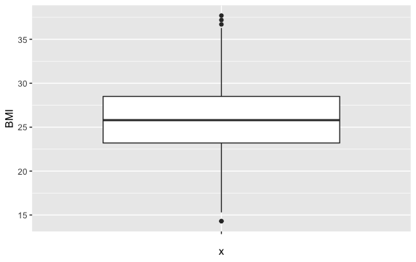
Boxplot with ggplot2
Simple boxplot showing the data distribution of BMI:
ggplot(data=mydata, mapping=aes(x=“”, y=BMI)) +
geom_boxplot()

Slide 32
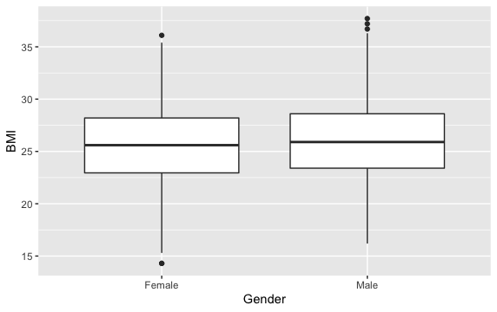
Boxplot with ggplot2 – by category
Boxplot showing the data distribution of BMI by Gender
ggplot(data=mydata, mapping=aes(x=Gender, y=BMI)) +
geom_boxplot()

Slide 33
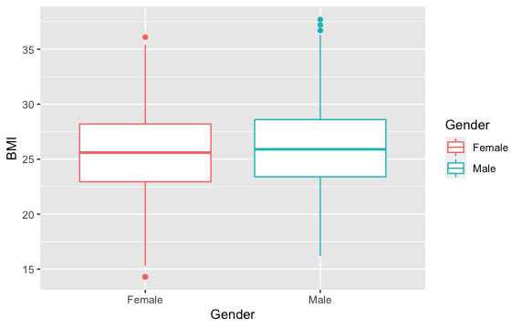
Boxplot with ggplot2 – by category and add color
Boxplot showing the data distribution of BMI by Gender with different colors
ggplot(data=mydata, mapping=aes(x=Gender, y=BMI, color=Gender)) + geom_boxplot()

Slide 34
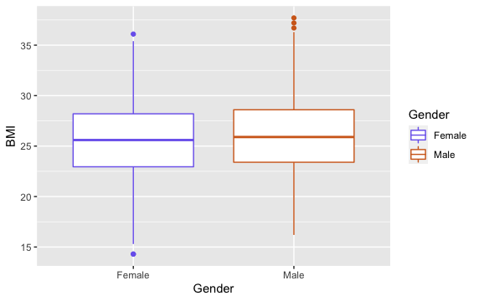
Boxplot with ggplot2 – by category and add color
Do you want to change the default colors?
scale_color_manual() changes the boxes border color
ggplot(data=mydata, mapping=aes(x=Gender, y=BMI, color=Gender)) +
geom_boxplot() +
scale_color_manual(values=c("slateblue2", "chocolate"))

Slide 35
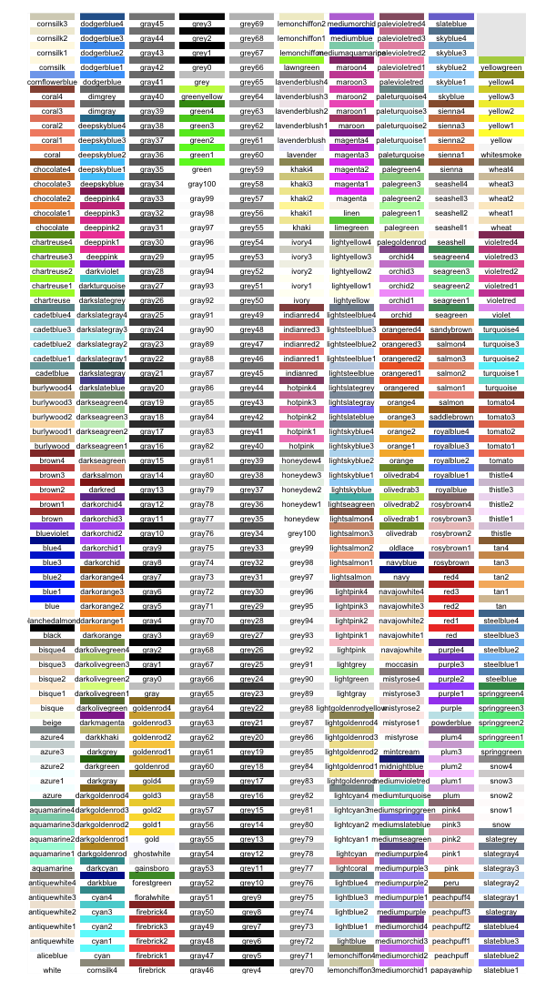
Colors in ggplot2
ggplot2 has many colors! You can google what these colors are to find out your options.
http://sape.inf.usi.ch/quick-reference/ggplot2/colour

Slide 36
Try it yourself:
Exercise 3.1.3: Box Plot
Produce a boxplot of the Age variable by Gender expression of all samples (i.e. x=Gender, y=Age)
Modify the previous boxplot so as to obtain different colors for each boxplot by gender
Use the scale_color_manual() function to change the default colors to hotpink and darkseagreen (i.e. values=c("hotpink ", " darkseagreen ")
Finally, add a title of your choice to the plot

Slide 37
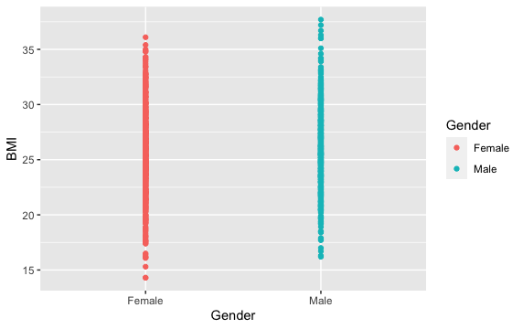
Dot Plot with ggplot2
Simple boxplot showing the data points for BMI as dots, by Gender
ggplot(data=mydata, mapping=aes(x=Gender, y=BMI, color=Gender)) +
geom_point()

Slide 38
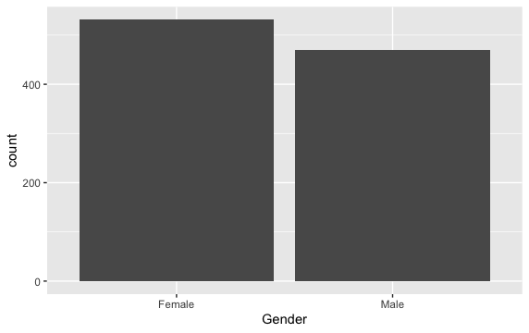
Bar Plot with ggplot2
A simple bar plot
ggplot(data=mydata, mapping=aes(x=Gender)) +
geom_bar()

Slide 39
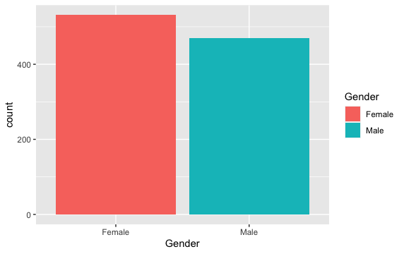
Bar Plot with ggplot2 – add color
A simple bar plot – use fill to add color to bars
ggplot(data=mydata, mapping=aes(x=Gender,fill=Gender)) +
geom_bar()

Slide 40
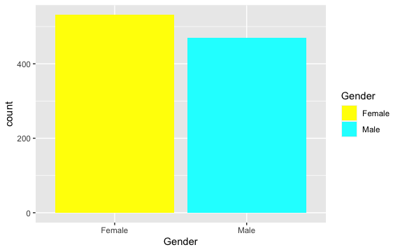
Bar Plot with ggplot2 – add new colors
A simple bar plot – use fill to add color to bars and scale_fill_manual to change colors
ggplot(data=mydata, mapping=aes(x=Gender,fill=Gender)) +
geom_bar() +
scale_fill_manual(values=c("yellow", "cyan"))

Slide 41
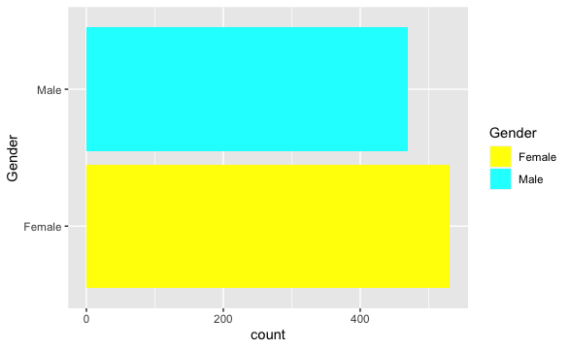
Bar Plot with ggplot2 – swap x and y axis
# Swapping x and y axis with coord_flip(): ggplot(data=mydata, mapping=aes(x=Gender,fill=Gender)) +
geom_bar() +
scale_fill_manual(values=c("yellow", "cyan")) + coord_flip()

Slide 42
Try it yourself:
Exercise 3.1.4: Bar Plot
Produce a bar plot of how many people in our dataset there are by Gender
Use the “fill” argument to change this barplot with different colors by Gender, such that those with and without Gender have different colors for the bars
Swap the x and y axis using coord_flip()

Slide 43
Bar Plot with Error Bars
We can create error bars on barplots.
Error bars give a general idea of how precise a measurement or how far from the reported value the true value might be.
If the value displayed on your barplot the result of an aggregation (like the mean value of several data points), you may want to display error bars.

Slide 44
Bar Plot with Error Bars
We build a basic barplot then add an extra layer using the geom_errorbar() function.
The function takes at least 3 arguments:
ymin and ymax: position of the bottom and the top of the error bar respectively
x: position on the X axis
Note: the lower and upper limits of your error bars must be computed before building the chart, and available in a column of the input data.

Slide 45
Bar Plot with Error Bars: Example
First, we need to aggregate our data so that it is ready to plot
#Create two subsets of data – for females and males
> mydata_Male <- subset(mydata, Gender == "Male")
> mydata_Female <- subset(mydata, Gender == "Female")

Slide 46
Bar Plot with Error Bars: Example
First, we need to aggregate our data so that it is ready to plot
#Create two subsets of data – for females and males
> mydata_Male <- subset(mydata, Gender == "Male")
> mydata_Female <- subset(mydata, Gender == "Female")
#Create a vector of means of BMI for males and females
> Means <- c(mean(mydata_Male$BMI), mean(mydata_Female$BMI))

Slide 47
Bar Plot with Error Bars: Example
First, we need to aggregate our data so that it is ready to plot
#Create two subsets of data – for females and males
> mydata_Male <- subset(mydata, Gender == "Male")
> mydata_Female <- subset(mydata, Gender == "Female")
#Create a vector of means of BMI for males and females
> Means <- c(mean(mydata_Male$BMI), mean(mydata_Female$BMI))
#Create a vector of standard deviations of BMI for males and females
> SD <- c(sd(mydata_Male$BMI), sd(mydata_Female$BMI))

Slide 48
Bar Plot with Error Bars: Example
First, we need to aggregate our data so that it is ready to plot
#Create two subsets of data – for females and males
> mydata_Male <- subset(mydata, Gender == "Male")
> mydata_Female <- subset(mydata, Gender == "Female")
#Create a vector of means of BMI for males and females
> Means<-c(mean(mydata_Male$BMI),mean(mydata_Female$BMI))
#Create a vector of standard deviations of BMI for males and females
> SD<-c(sd(mydata_Male$BMI),sd(mydata_Female$BMI))

Slide 49
Bar Plot with Error Bars: Example
First, we need to aggregate our data so that it is ready to plot
#Create two subsets of data – for females and males
> mydata_Male <- subset(mydata, Gender == "Male")
> mydata_Female <- subset(mydata, Gender == "Female")
#Create a vector of means of BMI for males and females
> Means <- c(mean(mydata_Male$BMI), mean(mydata_Female$BMI))
#Create a vector of standard deviations of BMI for males and females
> SD <- c(sd(mydata_Male$BMI), sd(mydata_Female$BMI))
#Create a vector of Genders
> Gender <- c("Male", "Female")

Slide 50
Bar Plot with Error Bars: Example
First, we need to aggregate our data so that it is ready to plot
#Create two subsets of data – for females and males
> mydata_Male <- subset(mydata, Gender == "Male")
> mydata_Female <- subset(mydata, Gender == "Female")
#Create a vector of means of BMI for males and females
> Means <- c(mean(mydata_Male$BMI), mean(mydata_Female$BMI))
#Create a vector of standard deviations of BMI for males and females
> SD <- c(sd(mydata_Male$BMI),sd(mydata_Female$BMI))
#Create a vector of Genders
> Gender <- c("Male","Female")
#Combine these three vectors into a data frame
> mydata_aggregate <- data.frame(Means, SD, Gender)

Slide 51
Bar Plot with Error Bars: Example
First, we need to aggregate our data so that it is ready to plot
#Create two subsets of data – for females and males
> mydata_Male <- subset(mydata, Gender == "Male")
> mydata_Female<-subset(mydata, Gender == "Female")
#Create a vector of means of BMI for males and females
> Means <- c(mean(mydata_Male$BMI), mean(mydata_Female$BMI))
#Create a vector of standard deviations of BMI for males and females
> SD <- c(sd(mydata_Male$BMI), sd(mydata_Female$BMI))
#Create a vector of Genders
> Gender <- c("Male", "Female")
#Combine these three vectors into a data frame
> mydata_aggregate <- data.frame(Means, SD, Gender)
> mydata_aggregate
Means SD Gender
1 25.8492 3.944868 Male
2 25.8492 3.944868 Female

Slide 52
Bar Plot with Error Bars: Example
First, we need to aggregate our data so that it is ready to plot
#Create two subsets of data – for females and males
> mydata_Male <- subset(mydata, Gender == "Male")
> mydata_Female <- subset(mydata, Gender == "Female")
#Create a vector of means of BMI for males and females
> Means <- c(mean(mydata_Male$BMI), mean(mydata_Female$BMI))
#Create a vector of standard deviations of BMI for males and females
> SD <- c(sd(mydata_Male$BMI), sd(mydata_Female$BMI))
#Create a vector of Genders
> Gender <- c("Male","Female")
#Combine these three vectors into a data frame
> mydata_aggregate <- data.frame(Means, SD, Gender)
> mydata_aggregate
Means SD Gender
1 25.8492 3.944868 Male
2 25.8492 3.944868 Female

Slide 53
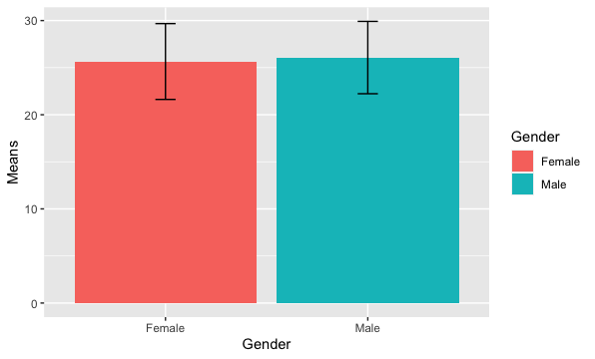
Bar Plot with Error Bars: Example
Now we can plot our aggregated data with error bars using geom_errorbar()
ggplot(mydata_aggregate, aes(x=Gender, y=Means, fill=Gender)) +
geom_bar(stat = "identity") +
geom_errorbar(aes(ymin=Means-SD, ymax=Means+SD), colour="black", width=.1)

Slide 54
Bar Plot with Error Bars: Example
Now we can plot our aggregated data with error bars using geom_errorbar()
ggplot(mydata_aggregate, aes(x=Gender, y=Means, fill=Gender)) +
geom_bar(stat = "identity") +
geom_errorbar(aes(ymin=Means-SD, ymax=Means+SD), colour="black", width=.1)
If you explicitly say stat = "identity" in geom_bar(), you're telling ggplot2 to skip the aggregation and that you'll provide the y values.
You’ll need the “u” in colour!

Slide 55
Try it yourself:
Exercise 3.1.5: Bar Plot with Error Bars
Following the steps I just outlined, try to reproduce my code and create two subsets of data – for females and males
mydata_Male<-subset(mydata,Gender==“Male”)
mydata_Female<-subset(mydata,Gender=“Female”)
Create a vector of means of BMI for males and females
Means<-c(mean(mydata_Male$BMI),mean(mydata_Female$BMI))
Create a vector of standard deviations of BMI for males and females
SD<-c(sd(mydata_Male$BMI),sd(mydata_Female$BMI))
Create a vector of Genders
Gender<-c("Male","Female")
Combine these three vectors into a data frame
mydata_aggregate<-data.frame(Means,SD,Gender)
Now we can plot our aggregated data using a bar plot with error bars using geom_bar and geom_errorbar
ggplot(mydata_aggregate, aes(x=Gender, y=Means, fill=Gender)) +
geom_bar(stat = "identity") +
geom_errorbar(aes(ymin=Means-SD, ymax=Means+SD), color="black", width=.1)

Slide 56
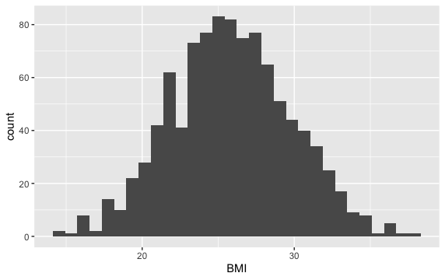
Histogram with ggplot2
Simple histogram on BMI (using the mydata frame):
ggplot(data=mydata, mapping=aes(x=BMI)) +
geom_histogram()
`stat_bin()` using `bins = 30`. Pick better value with `binwidth`.

Slide 57
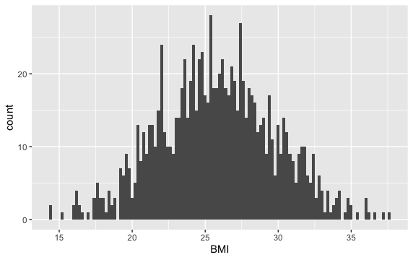
Histogram with ggplot2 – smaller binwidth
Simple histogram on BMI (using the mydata frame):
ggplot(data=mydata, mapping=aes(x=BMI)) +
geom_histogram(binwidth=0.2)
The smaller the binwidth, the more bars you will have in your histogram.

Slide 58
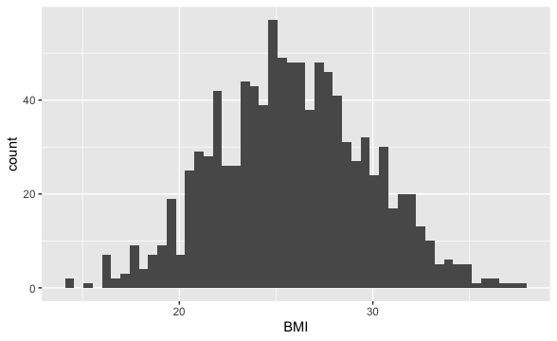
Histogram with ggplot2 – more bins
Simple histogram on BMI (using the mydata frame): can also change # of bins using bins parameter
ggplot(data=mydata, mapping=aes(x=BMI)) +
geom_histogram(bins=50)
The more bins, the more bars you will have in your histogram.

Slide 59
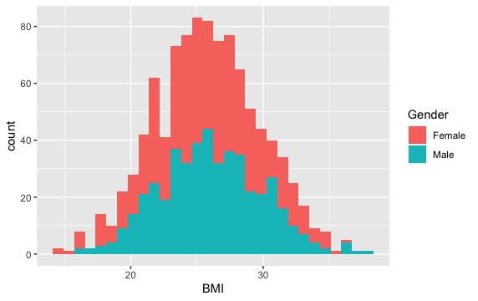
Histogram with ggplot2 – fill by category
Simple histogram of BMI by Gender
ggplot(data=mydata, mapping=aes(x=BMI,fill=Gender)) +
geom_histogram()

Slide 60
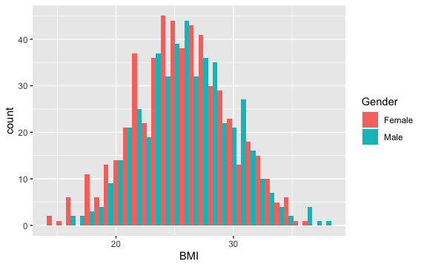
Histogram with ggplot2 – fill by category
By default, the histograms are stacked: change to position dodge (side by side):
ggplot(data=mydata, mapping=aes(x=BMI,fill=Gender)) +
geom_histogram(position=“dodge”)

Slide 61
Practical component to ggplot2
You can save plots You can save the plot in an object at any time and add layers to that object:
#Save in an object
p <- ggplot(data= df1 , mapping=aes(x=sample1, y=sample2)) +
geom_point()
# Add layers to that object
p + ggtitle(label="my first ggplot")

Slide 62
More layers to ggplot2
Add more layers:
xlab() to change the x axis label
ylab() to change the y axis label
xlim() to zoom in or out -- set the x-axis limits
ylim() to zoom in or out – set y-axis limits
p+ xlim(c(0,200)) +
ylim(c(0,100))+
xlab("Age in My Data")+
ylab("BMI in My Data")

Slide 63
More layers to ggplot2
Add more layers:
There are a few default global themes (background color, grid lines etc. all non-data display):
theme_bw()
theme_minimal()
theme_void()
theme_grey()
theme_dark()
theme_light()
p+ theme_dark()

Slide 64
More layers to ggplot2
theme can also be used to control graphical parameters such as axis text, ticks and labels, or legend texts and labels, etc.
#remove legend title
p+theme(legend.title=element_blank())
# Change font of legend text
p + theme(legend.title=element_blank(),
legend.text = element_text(colour="red", size = 8, face = "bold"))
# Put legend on the top of the plot
p + theme(legend.title=element_blank(),
legend.text = element_text(colour="red", size = 8, face = "bold"),
legend.position="top")
# Rotate x-axis labels
p2 + theme(legend.title=element_blank(),
legend.text = element_text(colour="red", size = 8, face = "bold"),
legend.position="top", axis.text.x = element_text(angle = 90))

Slide 65
Try it yourself:
Exercise 3.1.7: Additional Layers
Return to your scatterplot from 3.1.2. Save this scatterplot as a plot called “p” that you can continue adding layers to. Add more layers to p:
First, “zoom out” the plots:
set the x-axis limits from from 0 to 200 using the xlim() layer.
set the y-axis limits from from 6 to 13 using the ylim() layer.
Change the axis titles:
Give a new name to the x axis using xlab
Give a new name to the yaxis using ylab
Change the default theme to theme_minimal()
Return to your boxplot from 3.1.3. Save this as a plot called “p2” that you can continue adding layers to. Add more layers to p2 using theme and:
Remove the legend title
Change the font of the text in the legend
Re-position the legend to be on top of the plot
Rotate the x-axis labels
Add a color to the plot’s background

Slide 66
Statistical Inference

Slide 67
Statistical Inference
Estimation: Use sample statistics to estimate the unknown population parameter.
Point Estimate: the best single value to describe the unknown parameter.
Standard Error (SE): standard deviation of the sample statistic. Indicates how precise the point estimate is.
Confidence Interval (CI): the range with the most probable values for the unknown parameter with a (1-α)% level of confidence.
Hypothesis Testing: Test a specific statement (assumption) about the unknown parameter.

Slide 68
Statistical Inference: Example
Example:
You are asked to make recommendations about a new blood pressure lowering medication. You have data on subjects that received the medication and want to analyze each subject’s systolic blood pressure measure.

Slide 69
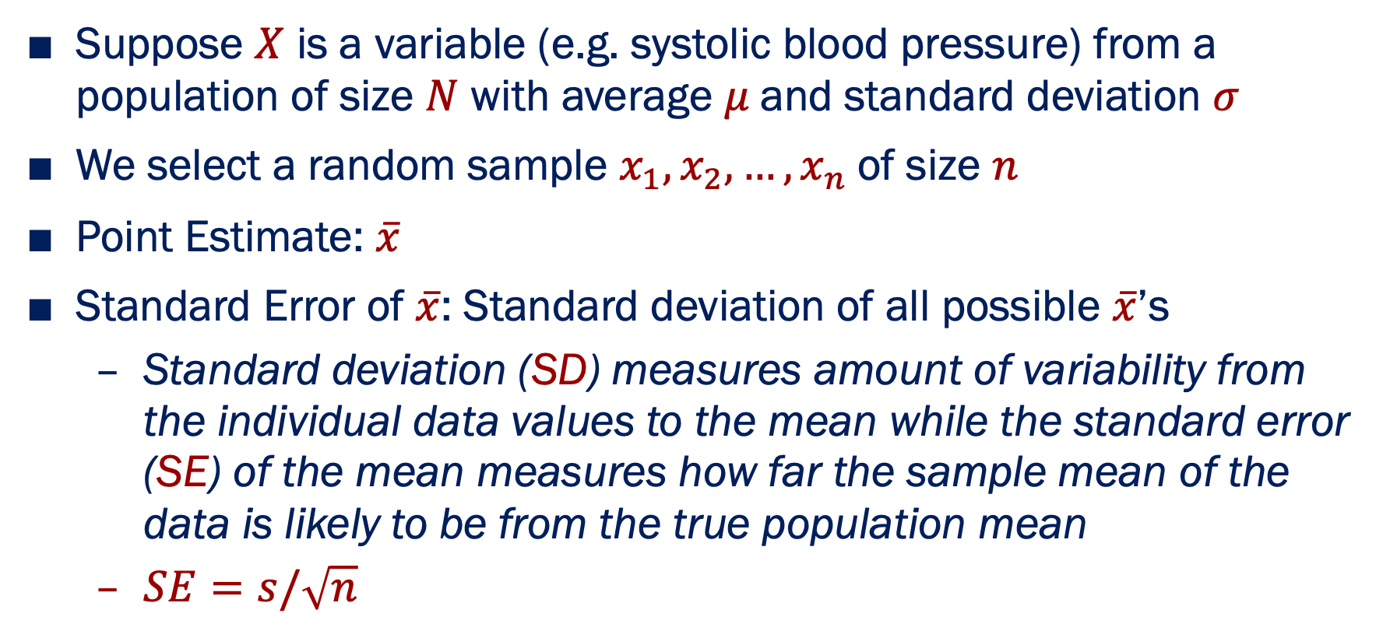
Statistical Inference: Estimation
Suppose $X$ is a variable (e.g. systolic blood pressure) from a population of size $N$ with average $μ$and standard deviation $σ$
We select a random sample $x_{1},x_{2},…,x_{n}$of size $n$
Point Estimate: $\overline{x}$
Standard Error of $\overline{x}$: Standard deviation of all possible $\overline{x}$’s
Standard deviation (SD) measures amount of variability from the individual data values to the mean while the standard error (SE) of the mean measures how far the sample mean of the data is likely to be from the true population mean
$SE=s/\sqrt{n}$

Slide 70
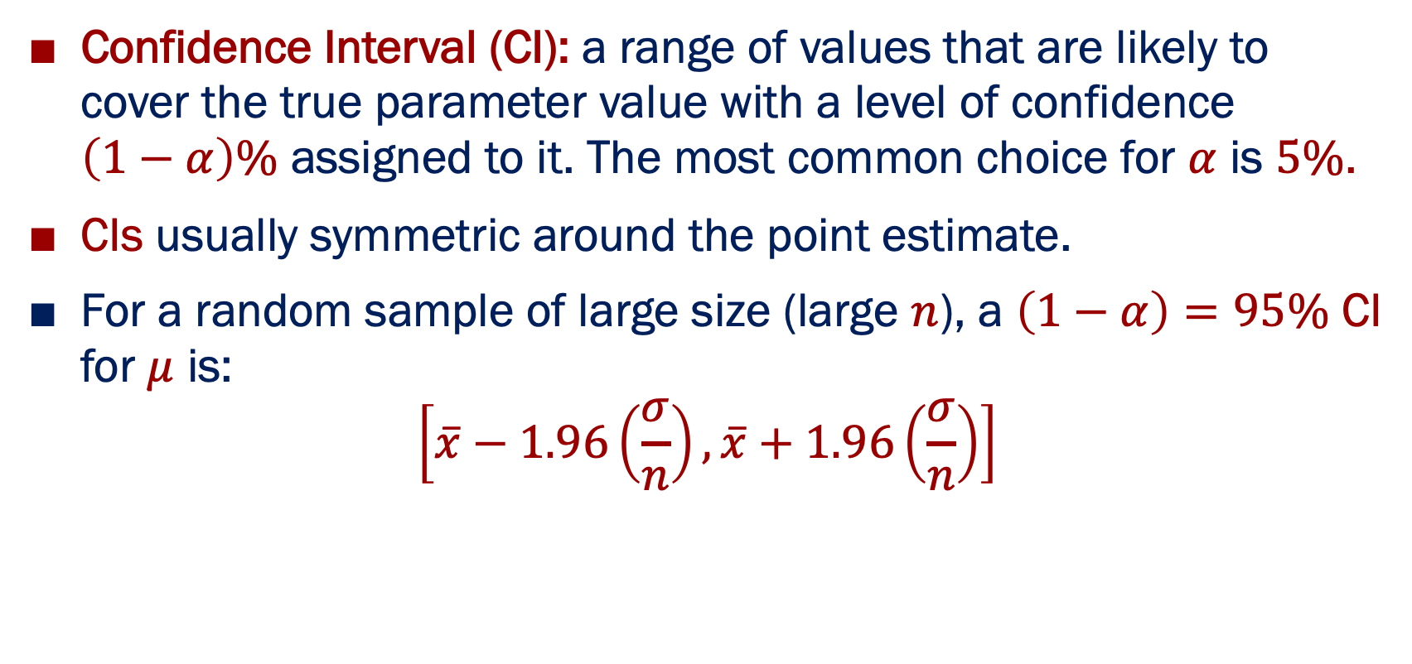
Statistical Inference: Confidence Interval Estimation
Confidence Interval (CI): a range of values that are likely to cover the true parameter value with a level of confidence $\left(1−α\right)\%$ assigned to it. The most common choice for $α$ is $5\%$.
CIs usually symmetric around the point estimate.
For a random sample of large size (large $n$), a $\left(1−α\right)=95\%$ CI for $μ$ is:
$$\left[\overline{x}−1.96\left(\frac{σ}{n}\right),\overline{x}+1.96\left(\frac{σ}{n}\right)\right]$$

Slide 71
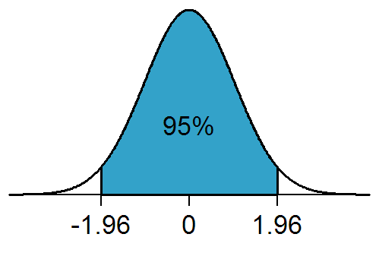
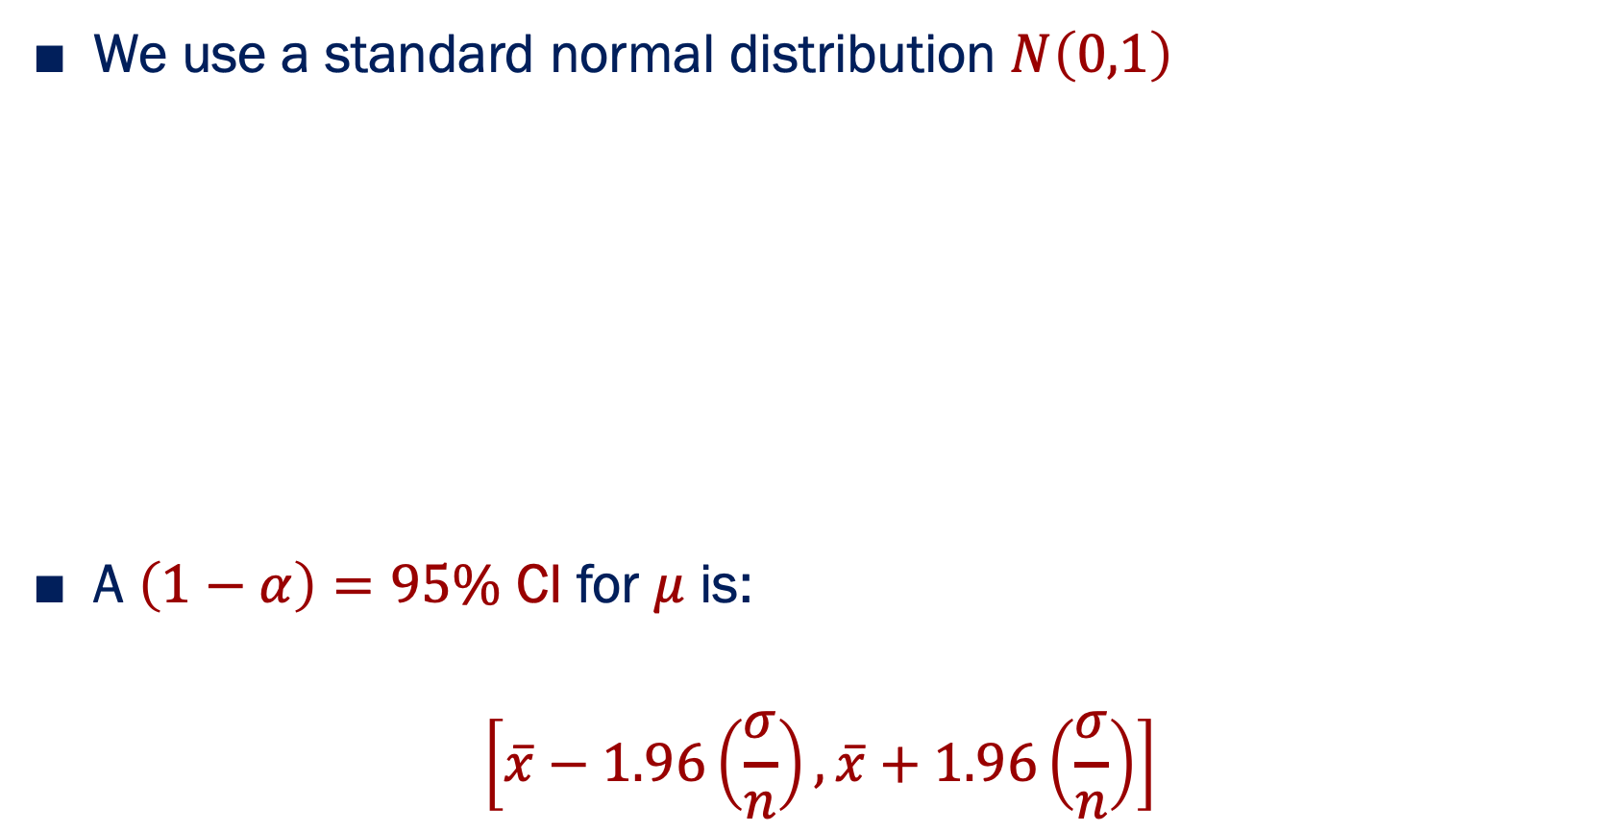
How do we derive a 95% CI?
We use a standard normal distribution $N\left(0,1\right)$
A $\left(1−α\right)=95\%$ CI for $μ$ is:
$$\left[\overline{x}−1.96\left(\frac{σ}{n}\right),\overline{x}+1.96\left(\frac{σ}{n}\right)\right]$$

Slide 72
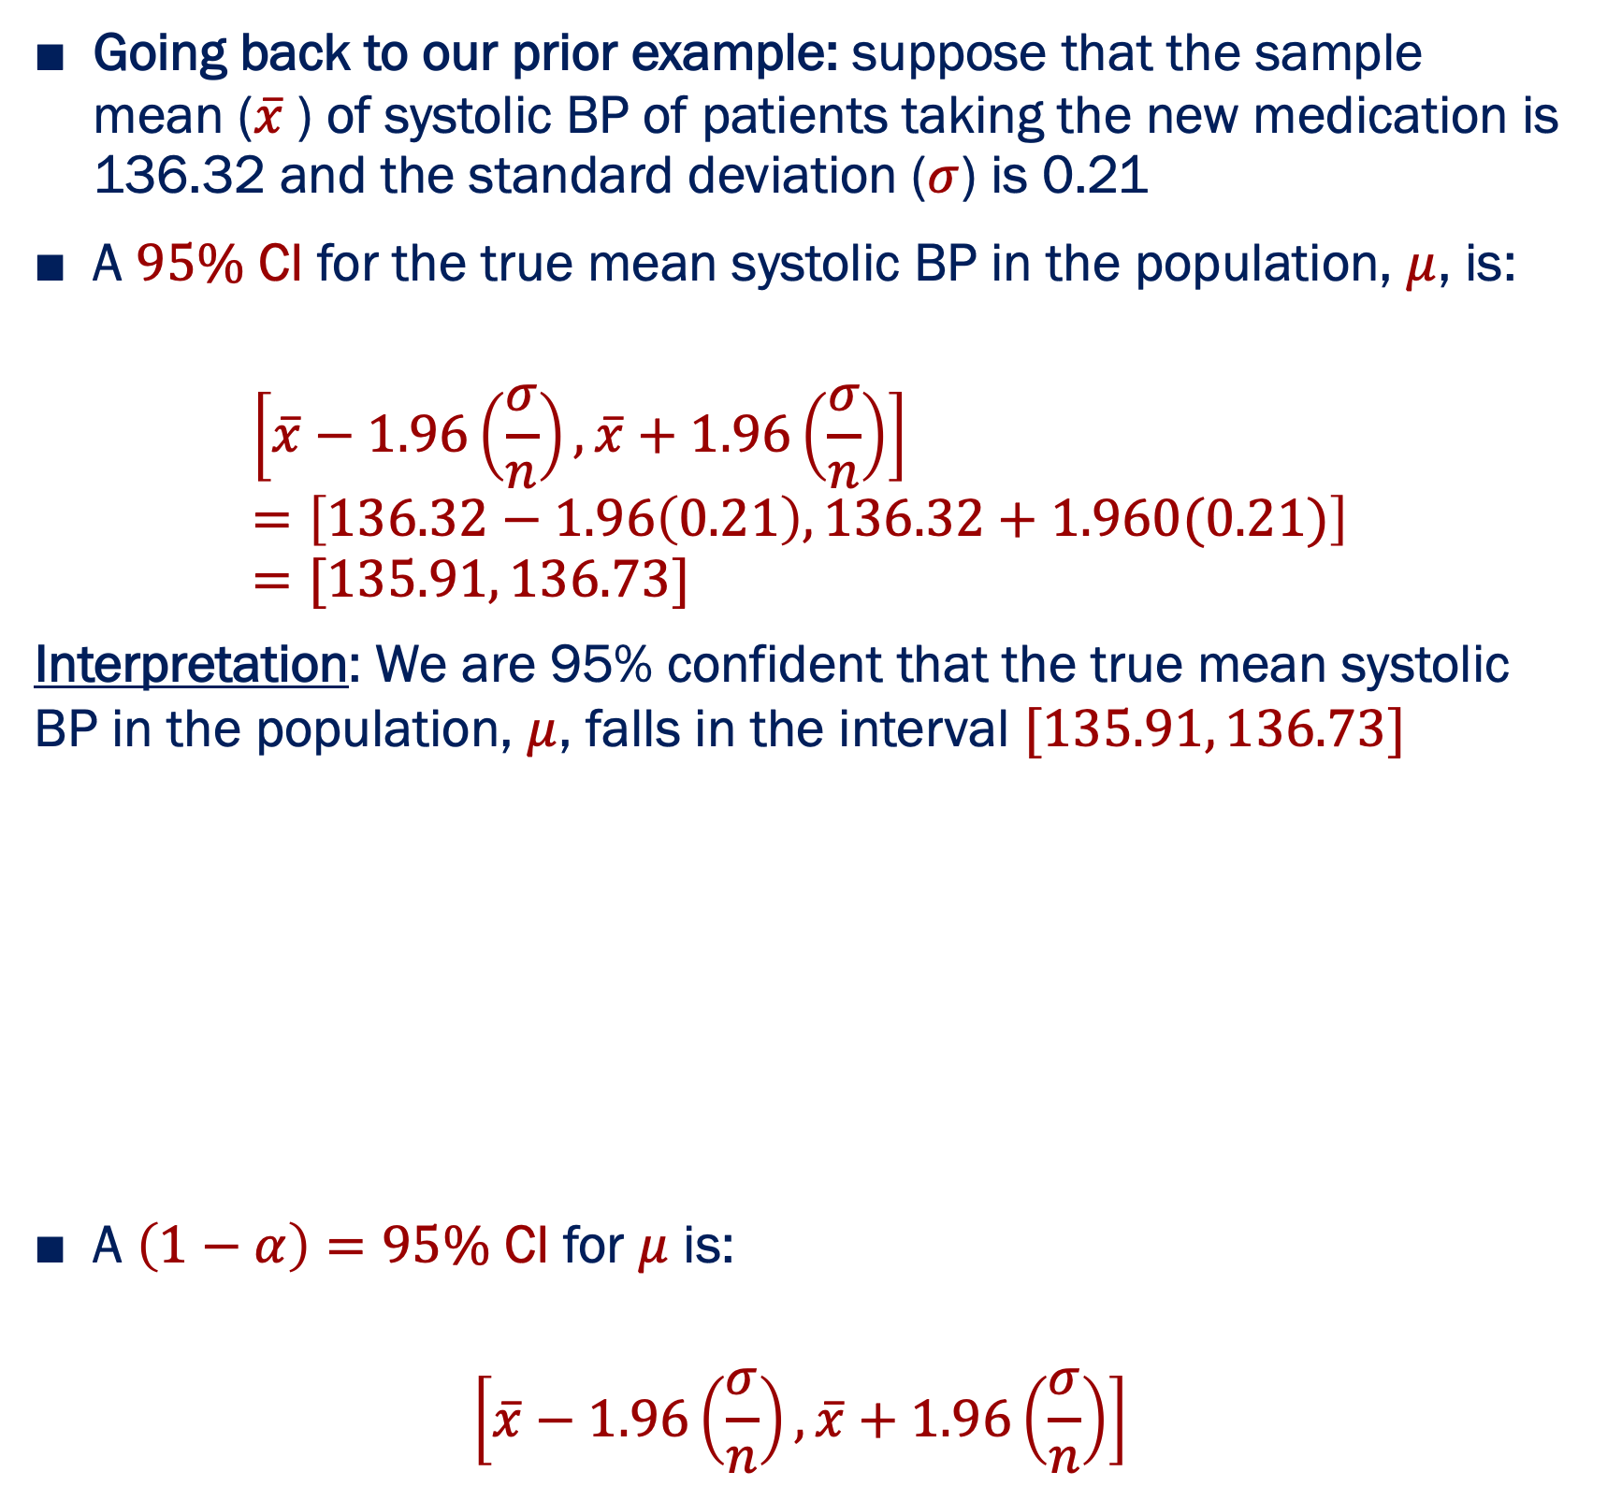
Calculating and Interpreting CI’s
Going back to our prior example: suppose that the sample mean ($\overline{x}$) of systolic BP of patients taking the new medication is 136.32 and the standard deviation ($σ$) is 0.21
A $95\%$ CI for the true mean systolic BP in the population, $μ$, is:
$$\left[\overline{x}−1.96\left(\frac{σ}{n}\right),\overline{x}+1.96\left(\frac{σ}{n}\right)\right]=\left[136.32−1.96\left(0.21\right),136.32+1.960(0.21)\right]=[135.91, 136.73]$$
Interpretation: We are 95% confident that the true mean systolic BP in the population, $μ$, falls in the interval $[135.91, 136.73]$
A $\left(1−α\right)=95\%$ CI for $μ$ is:
$$\left[\overline{x}−1.96\left(\frac{σ}{n}\right),\overline{x}+1.96\left(\frac{σ}{n}\right)\right]$$

Slide 73
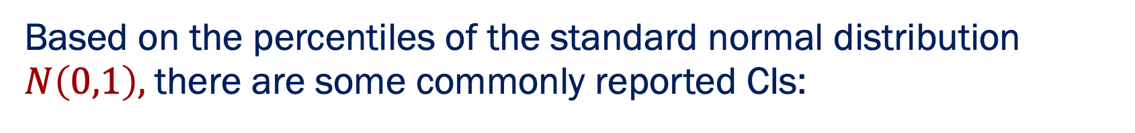
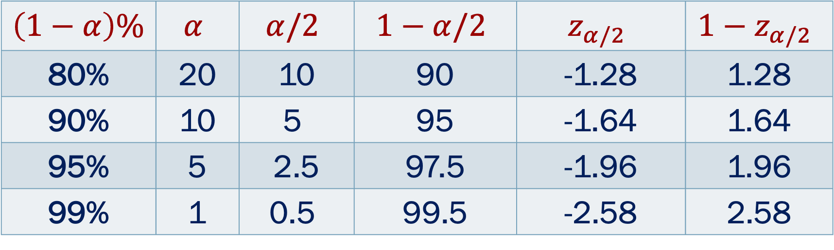
Statistical Inference: Confidence Interval Estimation
Based on the percentiles of the standard normal distribution $N\left(0,1\right),$there are some commonly reported CIs:
$$\left(1−α\right)\%$$ | $$α$$ | $$α/2$$ | $$1−α/2$$ | $$z_{α/2}$$ | $${1−z}_{α/2}$$
80% | 20 | 10 | 90 | -1.28 | 1.28
90% | 10 | $$\text{5}$$ | 95 | -1.64 | 1.64
95% | 5 | 2.5 | 97.5 | -1.96 | 1.96
99% | 1 | $$\text{0.5}$$ | 99.5 | -2.58 | 2.58

Slide 74
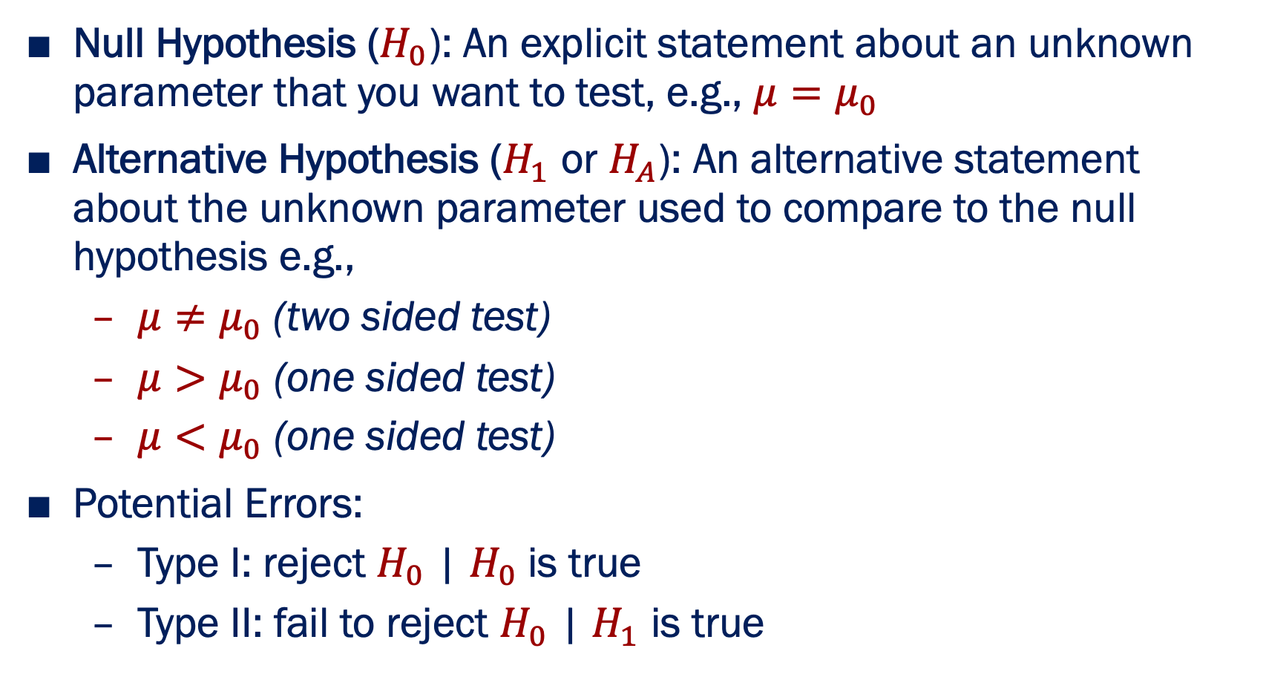
Statistical Inference: Hypothesis Testing
Null Hypothesis ($H_{0}$): An explicit statement about an unknown parameter that you want to test, e.g., $μ=μ_{0}$
Alternative Hypothesis ($H_{1}$ or $H_{A}$): An alternative statement about the unknown parameter used to compare to the null hypothesis e.g.,
$μ≠μ_{0}$ (two sided test)
$μ>μ_{0}$ (one sided test)
$μ<μ_{0}$ (one sided test)
Potential Errors:
Type I: reject $H_{0}$ | $H_{0}$is true
Type II: fail to reject $H_{0}$ | $H_{1}$ is true

Slide 75
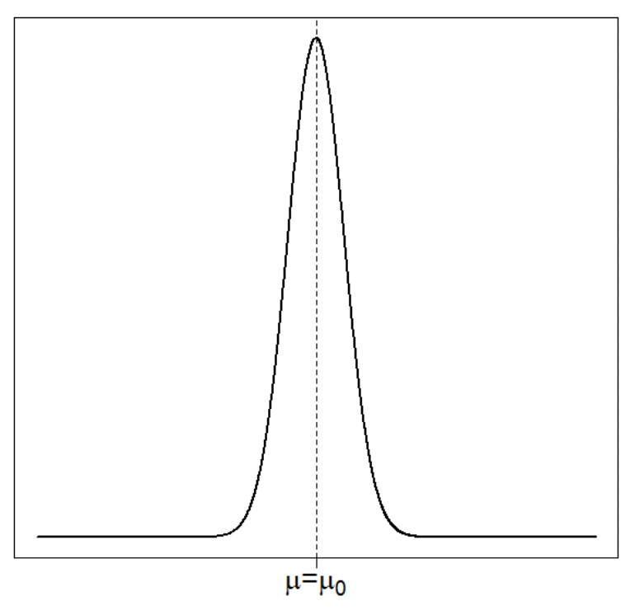
Hypothesis Testing: One vs. Two Sided Test
Two-sided test (two-tailed hypothesis): the direction of the effect is unknown (e.g., administration of experimental drug will result in a different systolic BP than that of current standard of care)
One-sided test (one-tailed hypothesis): outcome is expected in a single direction (e.g., administration of experimental drug will result in a decrease or increase in systolic BP)
One-Sided
Two-Sided
?
?

Slide 76
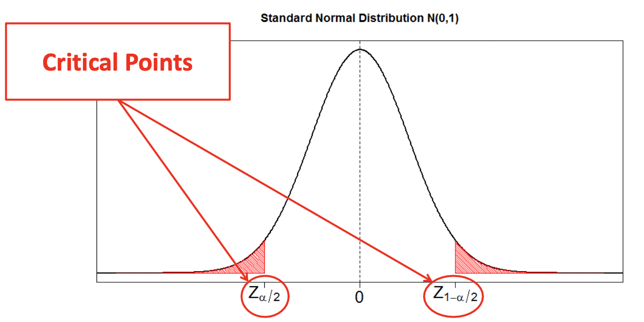
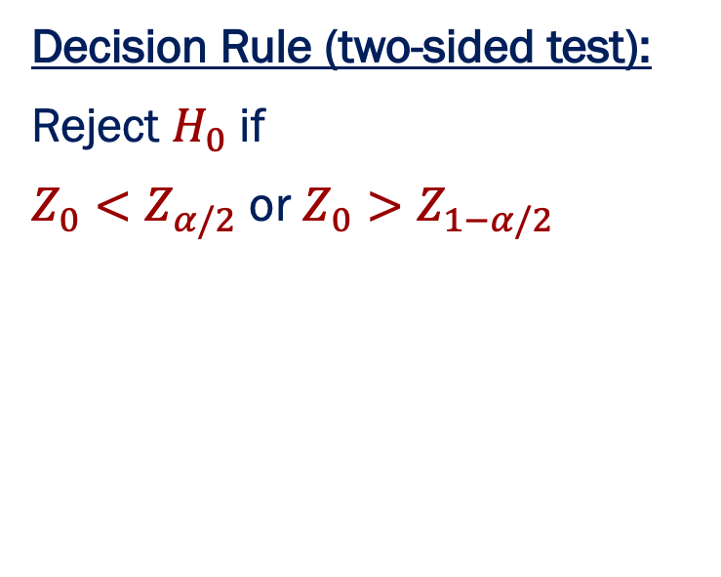
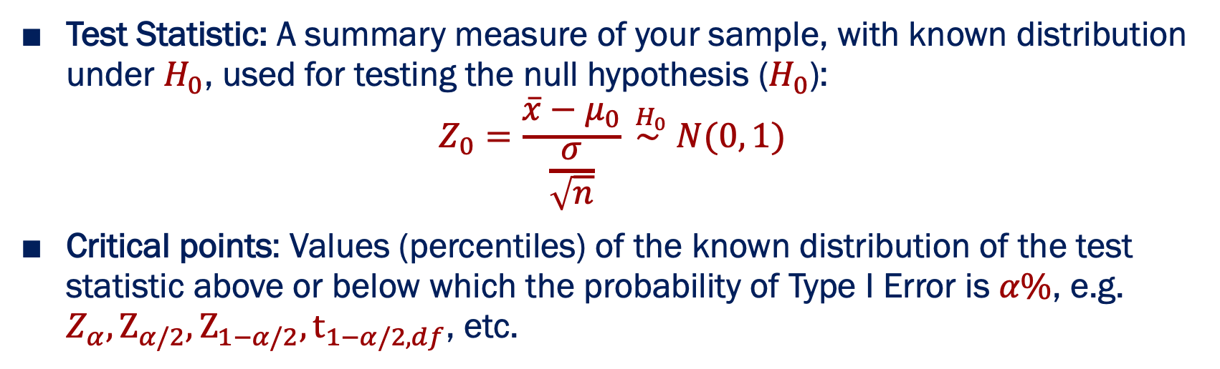
Hypothesis Testing: Test Statistic
Test Statistic: A summary measure of your sample, with known distribution under $H_{0}$, used for testing the null hypothesis ($H_{0}$):
$$Z_{0}=\frac{\overline{x}−μ_{0}}{\frac{σ}{\sqrt{n}}} \overset{H_{0}}{\sim } N(0, 1)$$
Critical points: Values (percentiles) of the known distribution of the test statistic above or below which the probability of Type I Error is $α\%$, e.g. $Z_{α}, Ζ_{α/2}, Ζ_{1−α/2},t_{1−α/2,df}$, etc.
Decision Rule (two-sided test):
Reject $H_{0}$ if
$Z_{0}<Z_{α/2}$ or $Z_{0}>Z_{1−α/2}$
Rejection Region

Slide 77
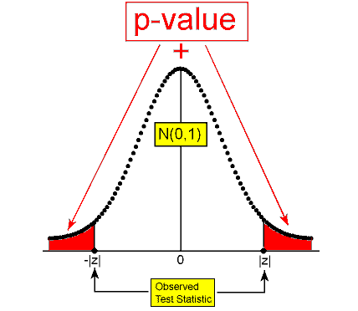
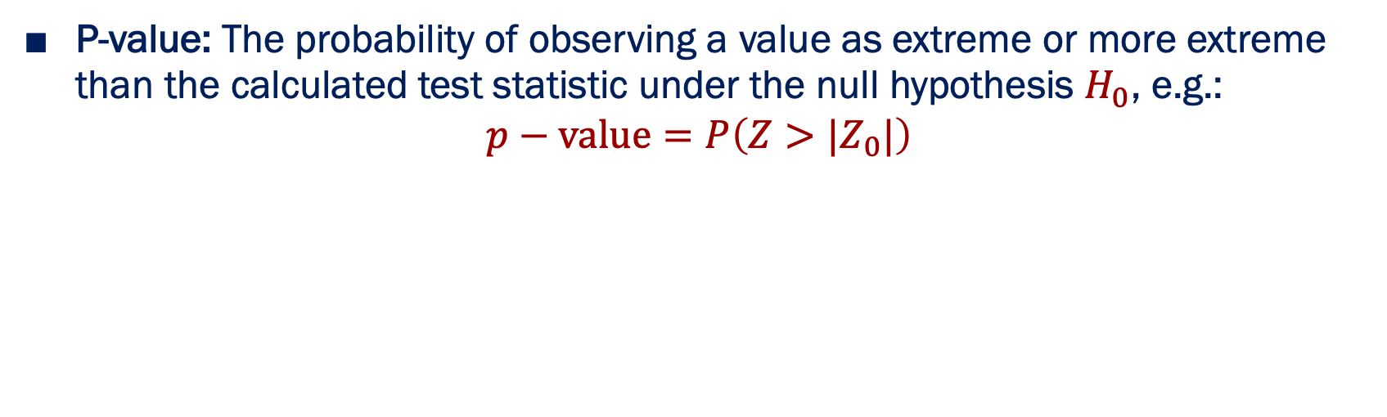
Hypothesis Testing: P-value
P-value: The probability of observing a value as extreme or more extreme than the calculated test statistic under the null hypothesis $H_{0}$, e.g.:
$$p−value=P\left(Z>{|Z}_{0}|\right)$$

Slide 78
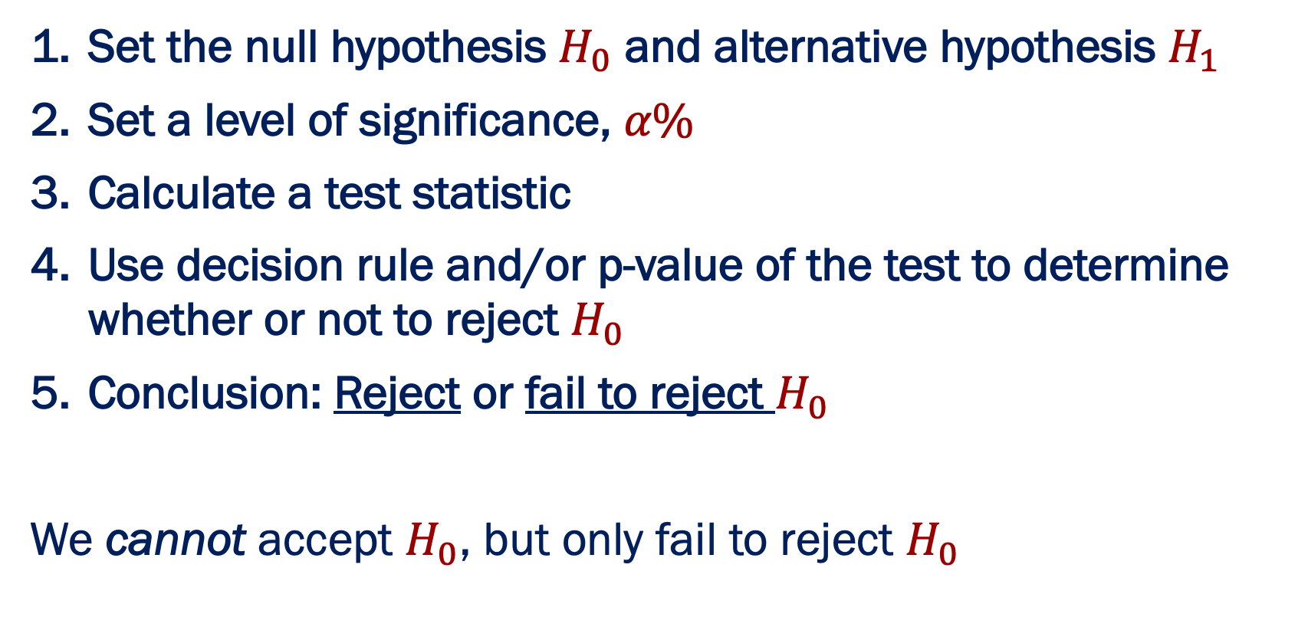
Hypothesis Testing: Steps
Set the null hypothesis $H_{0}$ and alternative hypothesis $H_{1}$
Set a level of significance, $α\%$
Calculate a test statistic
Use decision rule and/or p-value of the test to determine whether or not to reject $H_{0}$
Conclusion: Reject or fail to reject $H_{0}$
We cannot accept $H_{0}$, but only fail to reject $H_{0}$

Slide 79
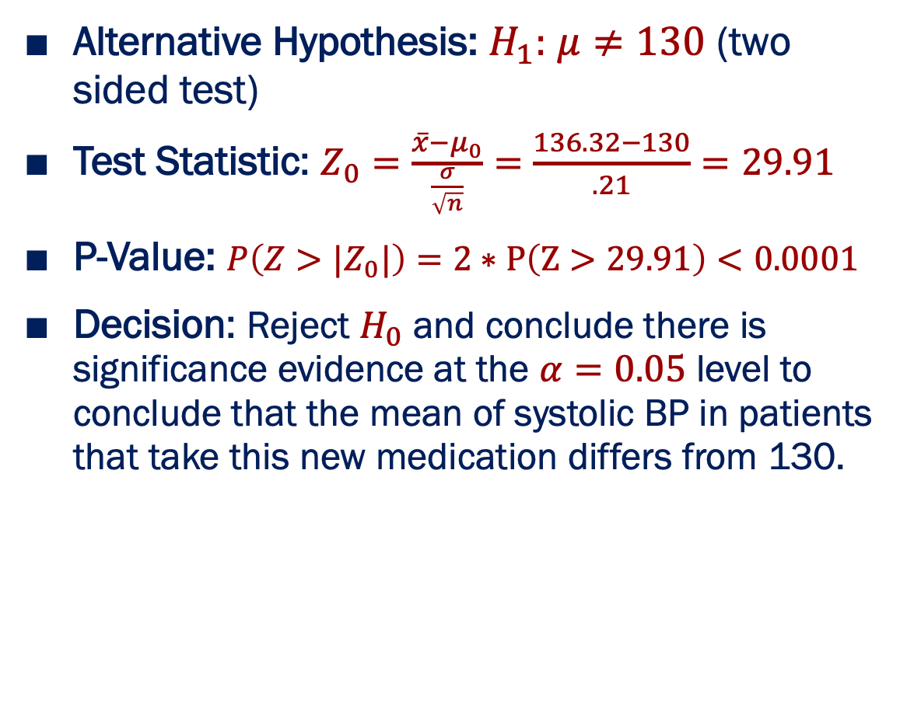
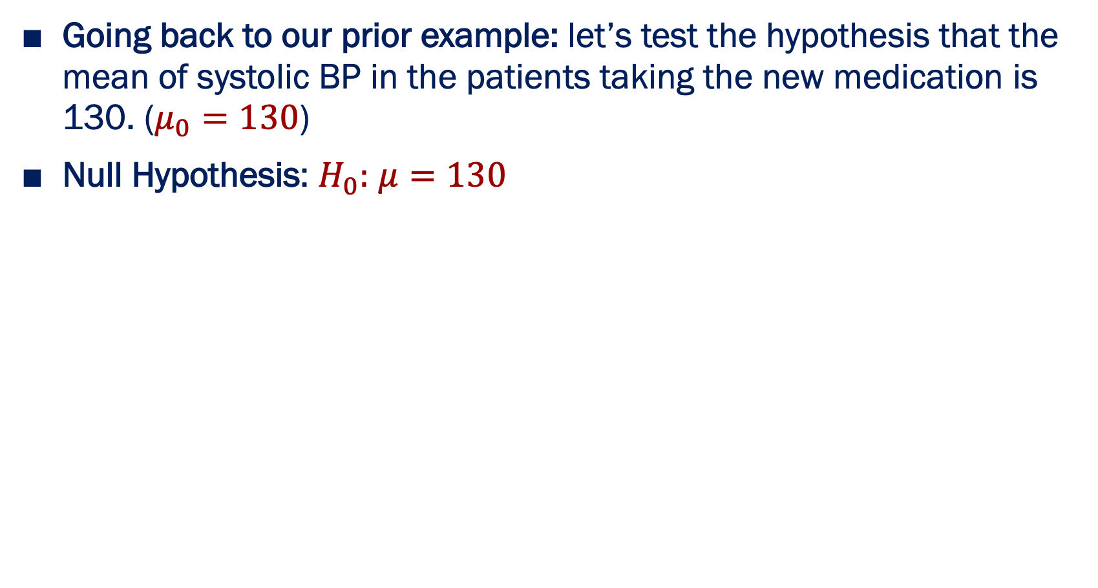
Hypothesis Testing: Example
Going back to our prior example: let’s test the hypothesis that the mean of systolic BP in the patients taking the new medication is 130. ($μ_{0}=130$)
Null Hypothesis: $H_{0}:$ $μ=130$
Alternative Hypothesis: $H_{1}:$ $μ≠130$ (two sided test)
Test Statistic: $Z_{0}=\frac{\overline{x}−μ_{0}}{\frac{σ}{\sqrt{n}}}=$ $\frac{136.32−130}{.21}=29.91$
P-Value: $P\left(Z>{|Z}_{0}|\right)=2∗P\left(Z>29.91\right)<0.0001$
Decision: Reject $H_{0}$ and conclude there is significance evidence at the $α=0.05$ level to conclude that the mean of systolic BP in patients that take this new medication differs from 130.
=130

Slide 80
Hypothesis tests & confidence intervals in R

Slide 81

List of Common Statistical Tests: Continuous Data Test for Population mean $μ$ or difference of two means $μ_{1}−μ_{2}$
 | # of Populations | Parametric | Function in R
Parametric | 1 | One-sample t One sample z | t.test(x,data = my_data)
 | 2, dependent | Paired t | t.test(y~x,paired=TRUE,data = my_data)
 | 2, independent | Two-sample t | t.test(y~x,data = my_data)
 | K, independent | One-way ANOVA | res.aov <- aov(y ~ x,data = my_data) summary(res.aov)
Nonparametric | 1 | Wilcoxon signed-rank | wilcox.test(x, data = my_data)
 | 2, dependent | Wilcoxon signed-rank | wilcox.test(x,y,paired=TRUE,data = my_data)
 | 2, independent | Wilcoxon rank-sum (Mann Whitney) | wilcox.test(x,y, data = my_data)
 | K, independent | Kruskal-Wallis | kruskal.test(x,y, data = my_data)
Sample Data:
Independent
Dependent
x (e.g. systolic BP of one group before treatment) | y (e.g. systolic BP of that SAME group after treatment)
119 | 130
122 | 139
… | …
142 | 121
x (e.g. systolic BP at one hospital) | y (e.g. systolic BP at another hospital)
119 | 130
122 | 139
… | …
142 | 121

Slide 82

List of Common Statistical Tests: Binary Data Test for Population proportion $p$ or difference of two means $p_{1}−p_{2}$
 | # of Populations | Parametric | Function in R
Parametric | 1 | One sample z | prop.test(x, n, p = NULL, alternative = "two.sided")
 | 2, independent | Two-sample z or Chi-square test | prop.test(x = c(x1, x2), n = c(n1, n2)) OR chisq.test(table(mydata$x1, mydata$x2))
 | 2, dependent | McNemar’s | mcnemar.test(table(mydata$x1, mydata$x2))
Nonparametric | 1 | Binomial test | binom.test(x, n, p = 0.5, alternative = "two.sided")
 | 2, independent | Fisher’s exact | fisher.test(table(mydata$x1, mydata$x2))
 | 2, dependent | McNemar’s | mcnemar.test(table(mydata$x1, mydata$x2))
One Population
x = # of successes
n = population size
Two Populations
x1, x2 = # of successes in group 1 and group 2, respectively (e.g. men and women)
n1, n2 = population size in group 1 and group 2, respectively
Raw Data
Data in Table Form
x | 160
n | 1000
x1 | 160
n1 | 1000
x1 | 212
n1 | 1000
Group | Success | Failure | Total
1 | 160 | 840 | 1000
2 | 212 | 788 | 1000
Total | 372 | 1628 | 2000

Slide 83
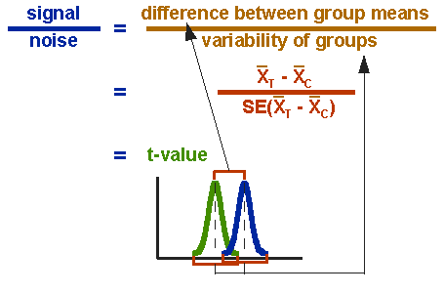
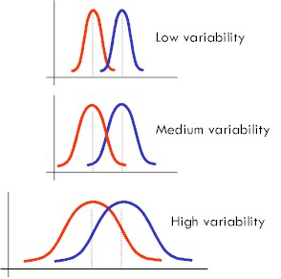
A very common hypothesis test: t.test()
•
The t.test() function
•
•
•
Runs several different kinds of t test Handles data formatted in different ways
I’ll only show a few of the more important ones

Slide 84
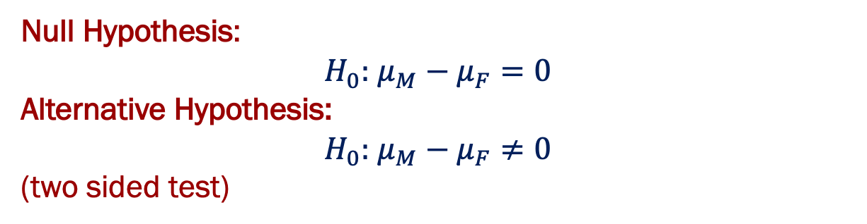
Independent samples t-test
Let’s test the hypothesis that the mean of BMI in male subjects ${(μ}_{M})$is equal to the mean of BMI in female subjects ${(μ}_{M})$.
Null Hypothesis:
$H_{0}:$ $μ_{M}−μ_{F}=0$
Alternative Hypothesis:
$H_{0}:$ $μ_{M}−μ_{F}≠0$
(two sided test)
R Code:
> t.test(
BMI
~ Gender,
data
= mydata )

Slide 85
Independent samples t-test
Let’s test the hypothesis that the mean of BMI in male subjects ${(μ}_{M})$is equal to the mean of BMI in female subjects ${(μ}_{M})$.
> t.test(
BMI
~ Gender,
data
= mydata )
Formula stating that:
BMI is the outcome (DV)
Gender is the predictor (IV)

Slide 86
Independent samples t-test
> t.test(
BMI
~ Gender,
data
= mydata )
Tells R to look for these variables inside the data frame mydata

Slide 87
> t.test(
BMI
~ Gender,
data
= mydata )
Welch Two Sample t-test
data: BMI by Gender
t = -1.6903, df = 992.06, p-value = 0.09128
alternative hypothesis: true difference in means is not equal to 0
95 percent confidence interval:
-0.90958578 0.06774816
sample estimates:
mean in group Female mean in group Male
25.65179 26.07271

Slide 88
Independent samples t-test without assuming equality of variances
> t.test(
BMI
~ Gender,
data
= mydata )
Welch Two Sample t-test
data: BMI by Gender
t = -1.6903, df = 992.06, p-value = 0.09128
alternative hypothesis: true difference in means is not equal to 0
95 percent confidence interval:
-0.90958578 0.06774816
sample estimates:
mean in group Female mean in group Male
25.65179 26.07271

Slide 89
Reminds us what variables we ran the test on
> t.test(
BMI
~ Gender,
data
= mydata )
Welch Two Sample t-test
data: BMI by Gender
t = -1.6903, df = 992.06, p-value = 0.09128
alternative hypothesis: true difference in means is not equal to 0
95 percent confidence interval:
-0.90958578 0.06774816
sample estimates:
mean in group Female mean in group Male
25.65179 26.07271

Slide 90
Test statistic, degrees of freedom, p-value
> t.test(
BMI
~ Gender,
data
= mydata )
Welch Two Sample t-test
data: BMI by Gender
t = -1.6903, df = 992.06, p-value = 0.09128
alternative hypothesis: true difference in means is not equal to 0
95 percent confidence interval:
-0.90958578 0.06774816
sample estimates:
mean in group Female mean in group Male
25.65179 26.07271

Slide 91
Two sided test
> t.test(
BMI
~ Gender,
data
= mydata )
Welch Two Sample t-test
data: BMI by Gender
t = -1.6903, df = 992.06, p-value = 0.09128
alternative hypothesis: true difference in means is not equal to 0
95 percent confidence interval:
-0.90958578 0.06774816
sample estimates:
mean in group Female mean in group Male
25.65179 26.07271

Slide 92
Confidence interval for the difference between the two means
> t.test(
BMI
~ Gender,
data
= mydata )
Welch Two Sample t-test
data: BMI by Gender
t = -1.6903, df = 992.06, p-value = 0.09128
alternative hypothesis: true difference in means is not equal to 0
95 percent confidence interval:
-0.90958578 0.06774816
sample estimates:
mean in group Female mean in group Male
25.65179 26.07271

Slide 93
The group means
> t.test(
BMI
~ Gender,
data
= mydata )
Welch Two Sample t-test
data: BMI by Gender
t = -1.6903, df = 992.06, p-value = 0.09128
alternative hypothesis: true difference in means is not equal to 0
95 percent confidence interval:
-0.90958578 0.06774816
sample estimates:
mean in group Female mean in group Male
25.65179 26.07271

Slide 94
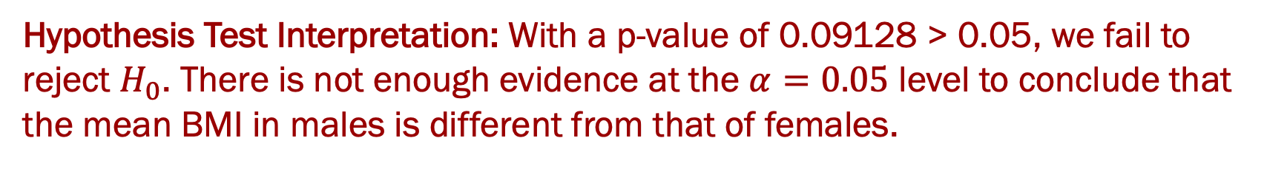
Interpreting Results from R
Recall: we are testing the hypothesis that the mean of BMI in male subjects ${(μ}_{M})$ is equal to the mean of BMI in female subjects ${(μ}_{M})$.
> t.test(
BMI
~ Gender,
data
= mydata )
Welch Two Sample t-test
data: BMI by Gender
t = -1.6903, df = 992.06, p-value = 0.09128
alternative hypothesis: true difference in means is not equal to 0
95 percent confidence interval:
-0.90958578 0.06774816
sample estimates:
mean in group Female mean in group Male
25.65179 26.07271
Hypothesis Test Interpretation: With a p-value of 0.09128 > 0.05, we fail to reject $H_{0}$. There is not enough evidence at the $α=0.05$ level to conclude that the mean BMI in males is different from that of females.

Slide 95
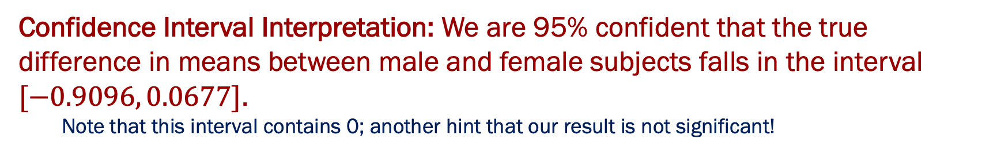
Interpreting Results from R
Recall: we are testing the hypothesis that the mean of BMI in male subjects ${(μ}_{M})$ is equal to the mean of BMI in female subjects ${(μ}_{M})$.
> t.test(
BMI
~ Gender,
data
= mydata )
Welch Two Sample t-test
data: BMI by Gender
t = -1.6903, df = 992.06, p-value = 0.09128
alternative hypothesis: true difference in means is not equal to 0
95 percent confidence interval:
-0.90958578 0.06774816
sample estimates:
mean in group Female mean in group Male
25.65179 26.07271
Confidence Interval Interpretation: We are 95% confident that the true difference in means between male and female subjects falls in the interval $[−0.9096, 0.0677]$.
Note that this interval contains 0; another hint that our result is not significant!

Slide 96
Variations on the t-test
> # one-sided
test
> t.test(
BMI
~ Gender,
data
= mydata, alternative = “greater” )
The alternative argument has three options...
“two.sided”
“greater”
“less”

Slide 97
Variations on the t-test
> # one-sided
test
> t.test(
BMI
~ Gender,
data
= mydata, alternative = “greater” )
> # Student
t-test
(assumes
equal
variance)
> t.test(
BMI
~ Gender,
data
= mydata, var.equal = TRUE)
This tells R that you’re happy to trust the equal variance assumption

Slide 98
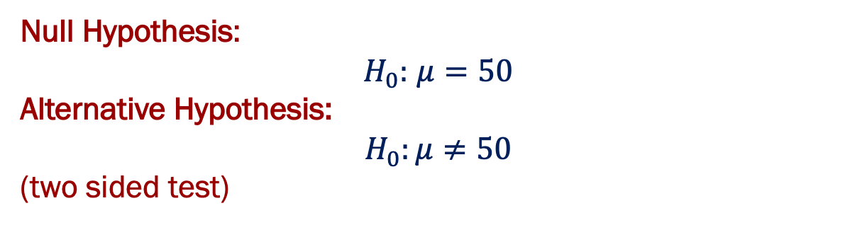
One sample t-test
Let’s test the hypothesis that the mean Age of subjects $\left(μ\right)$ is equal to 50.
Null Hypothesis:
$H_{0}:$ $μ=50$
Alternative Hypothesis:
$$H_{0}:μ≠50$$
(two sided test)
> t.test(x = mydata$Age, mu=50)
Formula states that the variable we want to test is Age from data set mydata
The mean we want to test if Age is equal to is 50

Slide 99
One sample t-test
Let’s test the hypothesis that the mean Age of subjects $\left(μ\right)$ is equal to 50.
Null Hypothesis:
$H_{0}:$ $μ=50$
Alternative Hypothesis:
$$H_{0}:μ≠50$$
(two sided test)
> t.test(x = mydata$Age, mu=50)
One Sample t-test
data: data$Age
t = 15.157, df = 999, p-value < 2.2e-16
alternative hypothesis: true mean is not equal to 50
95 percent confidence interval:
54.26301 55.53099
sample estimates:
mean of x
54.897

Slide 100
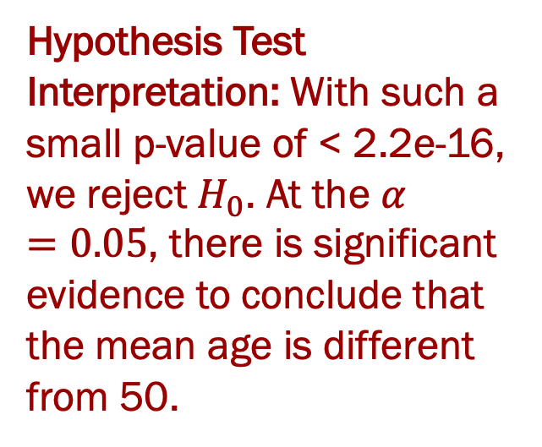
One sample t-test: interpreting results
Let’s test the hypothesis that the mean Age of subjects $\left(μ\right)$ is equal to 50.
Null Hypothesis:
$H_{0}:$ $μ=50$
Alternative Hypothesis:
$$H_{0}:μ≠50$$
(two sided test)
Hypothesis Test Interpretation: With such a small p-value of < 2.2e-16, we reject $H_{0}$. At the $α=0.05$, there is significant evidence to conclude that the mean age is different from 50.
> t.test(x = mydata$Age, mu=50)
One Sample t-test
data: data$Age
t = 15.157, df = 999, p-value < 2.2e-16
alternative hypothesis: true mean is not equal to 50
95 percent confidence interval:
54.26301 55.53099
sample estimates:
mean of x
54.897

Slide 101

One sample t-test: interpreting results
Let’s test the hypothesis that the mean Age of subjects $\left(μ\right)$ is equal to 50.
Null Hypothesis:
$H_{0}:$ $μ=50$
Alternative Hypothesis:
$$H_{0}:μ≠50$$
(two sided test)
Confidence Interval Interpretation:
We are 95% confident that the true mean age falls in the interval $[54.26, 55.53]$.
Note that this interval does NOT contain 50; a good hint that our result is significant and we can reject $H_{0}$!
> t.test(x = mydata$Age, mu=50)
One Sample t-test
data: data$Age
t = 15.157, df = 999, p-value < 2.2e-16
alternative hypothesis: true mean is not equal to 50
95 percent confidence interval:
54.26301 55.53099
sample estimates:
mean of x
54.897

Slide 102

Regression Models
Like hypothesis testing, regression models are also a method of inferential statistics
Regression models are often used to identify the relationship between one outcome variable and one or more predictor variables (covariates)
In a regression model, we are solving for regression parameters, $βs,$ which describe the relationship between the predictor variable and the response
Some common types of regression models in biostatistics:
Linear regression
Logistic regression
Cox Proportional Hazards regression (survival analysis)

Slide 103

Linear Regression
Use when outcome variable is continuous
Use when you believe your predictor variable and outcome are related linearly
Regression Coefficient, $β$: measure of association between the outcome ($y$) and exposure variable ($x$) where model is $y=α+βx$
Example: Want to investigate relationship between lung function as measured by forced exhalation volume (FEV) $(y)$ and age $(x)$.
Estimated Regression Equation: FEV = 0.01165 + 0.26721 × age
Interpretation of slope: For every 1 year increase in age, the average FEV increases by 0.26721 units.

Slide 104


Statistical Modeling in R: Linear Regression
Linear Regression: use when outcome variable ($y$) is continuous, and you have one or more covariates ($x_{1},x_{2},…,x_{p}$) of any type (continuous or categorical)
Sample Data:
y (e.g. systolic BP) | x1 (e.g. weight) | x2 (e.g. gender, 0=female, 1=male) | x3 (e.g. severity of pain, 1=mild, 2=moderate, 3=severe)
119 | 178.36 | 1 | 3
122 | 147.90 | 1 | 1
… | … | … | …
142 | 205.64 | 0 | 2
Model | Variables | Code in R
Simple Linear Regression | Outcome (dependent variable) = $y$ Covariate (independent variable) = $x$ | lm(y~x,data=mydata)
Multiple Linear Regression | Outcome (dependent variable) = $y$ Covariates (independent variables) = $x_{1},x_{2},x_{3}$ | lm(y~x1+x2+x3,data=mydata)

Slide 105
That’s it for today!
But….
there is so much more that can be done in R!
If any questions come up throughout research, please feel free to reach out!
Nina Alfaro, alfarom@pennmedicine.upenn.edu

Slide 106
Thank You!
Questions?

Slide 107
References
Introduction to Biostatistics, Larry Winner, Department of Statistics University of Florida
Introduction to Biostatistics, Jonggyu Baek, University of Massachusetts Medical School
Introduction to Biostatistics, University of Georgia
Introduction to Biostatistics for Clinical and Translational Researchers, KUMC Departments of Biostatistics & Internal Medicine, University of Kansas Cancer Center
Introduction to R, Dan Navarro (daniel.navarro@adelaide.edu.au) School of Psychology, University of Adelaide, ua.edu.au/ccs/people/dan CSIRO R Workshop, 28-Nov-2013
Introduction to R 2021, Sarah Bonin, https://biocorecrg.github.io/CRG_RIntroduction/
Introduction to Biostatistics & R 2022, Lillian Boe, University of Pennsylvania

